Slide 1

OPTIMIZING SUPPLY CHAIN PERFORMANCE: PREDICTING LATE DELIVERIES AND SEGMENT RISK

Slide 2
INTRODUCTION:
Today’s global supply chains face increasing pressure to deliver goods faster, cheaper, and with fewer errors. Delayed deliveries not only disrupt operations but erode customer trust and profitability. Our project addresses this challenge through data-driven analysis and machine learning.
Research Questions - What are the most significant drivers of late deliveries in supply chains, and how can we segment customers by delivery risk and profitability using predictive analytics?
Predict late deliveries using historical order data
Identify if there are any operational inefficiencies
Segment customers based on risk and value

Slide 3
Literature Review
Flepisi & Mlambo (2021)
Literature Review
Poor scheduling, contractor delays, and external disruptions.
Tang (2006)
Tang categorized supply chain risks into operational disruptions and market risks, highlighting that predictive modeling can play a key role in dynamically adjusting procurement and fulfillment strategies.
Katsaliaki et al. (2020):
Ripple effects of minor logistics failures; importance of resilience.
Katsaliaki & Steinberg
Steinberg et al. (2023):
Emphasized the role of shipping mode and AI-based route planning in reducing delivery risks.
Machine learning can predict supplier delays and reduce revenue loss.

Slide 4
Methodology
Research Design and Analytical Framework
Dataset
EDA
ML Pipeline:
Segmentation Approach
180,519 records
53 variables across customer, shipping, sales, and operational data
Source: DataCo Supply Chain Dataset
Missing value treatment
Summary stats
Visualizations: Histograms, violin plots, heatmaps
Best Model: Random Forest Classifier
Preprocessing: One-hot encoding, frequency encoding
Target: Late_delivery_risk
Feature Importance Analysis
Rule-based logic + K-Means clustering
Aggregated features: Avg late risk, total sales, benefit, shipping patterns
Customer labels: Low, Medium, High Risk
Supply Chain Management

Slide 5
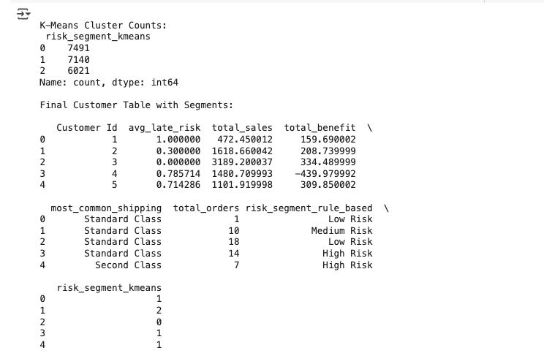
Results
RQ1: What factors contribute most to late deliveries?
The Random Forest model identified ‘Delivery Status_Late delivery’ as the dominant predictor, contributing 74.1% to late delivery prediction.
Other key features: Shipping Mode (Standard Class – 6.6%) and ‘Shipping on time’ (14.7%).
Customer and financial variables like Sales per Customer (<0.02%) had almost no predictive influence.
Conclusion: Operational factors (delivery status, shipping method) are the main drivers of delays.
RQ2: How can customers be segmented by risk and value?
Rule-Based Segmentation: High Risk: 3,434 customers. Medium Risk: 6,100 customers Low Risk: 11,118 customers
K-Means Clustering: Formed 3 balanced clusters (6,021, 7,491, 7,140) using avg_late_risk, total_sales, and total_benefit.
Insight: Segmentation reveals that high-risk + high-value customers are top priorities for fast shipping and loyalty efforts.

Slide 6
DISCUSSION AND CONCLUSION
Interpretation
Limitations
Future Scope
Conclusion
01
02
03
04
Delivery status was a strong predictor but also risks data leakage if used at prediction time. Hence such strong predictor were removed
Dataset may not reflect seasonality or post-COVID shifts in logistics.
Machine learning effectively identifies delay drivers.
Delivery status (operational signals) far outweigh financial or geographic factors.
Customer segmentation adds strategic value by flagging high-risk clients with high revenue impact.
The Research could be further extended to focus more on the important features – This would help in strategy and cost managment
Predictive models can empower logistics teams to act proactively.
Risk segmentation transforms raw data into clear business strategies.

